Slide 1
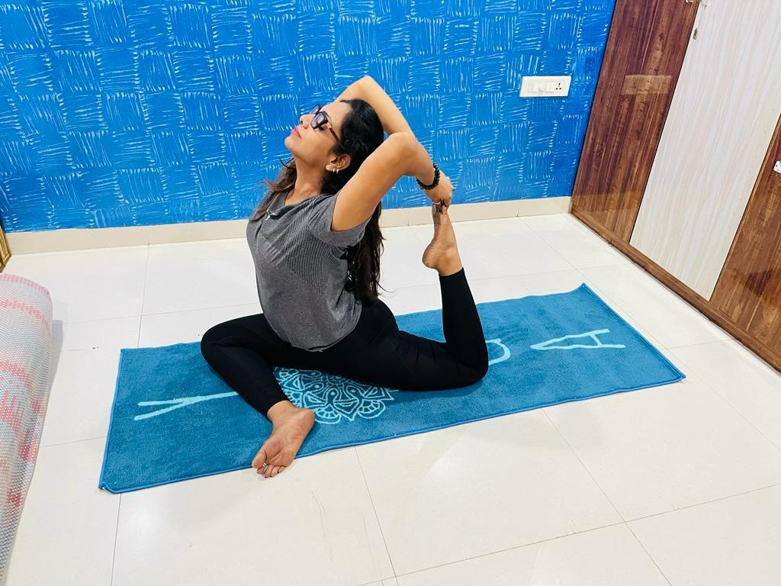
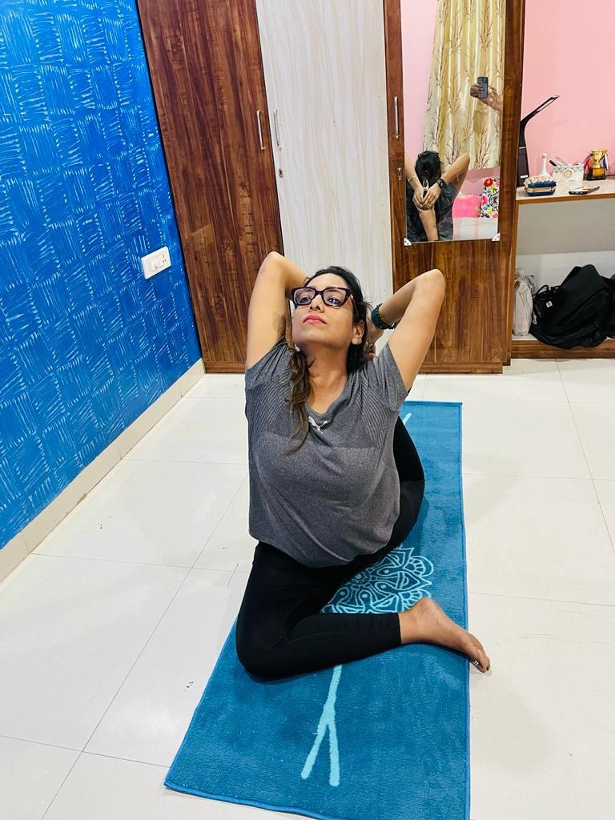
1ST POSITION Dr Alka Jowhary -Raipur Menopause society DOB - 20/11/1983 Name of Aasan : Rajkapotaasan

Slide 2
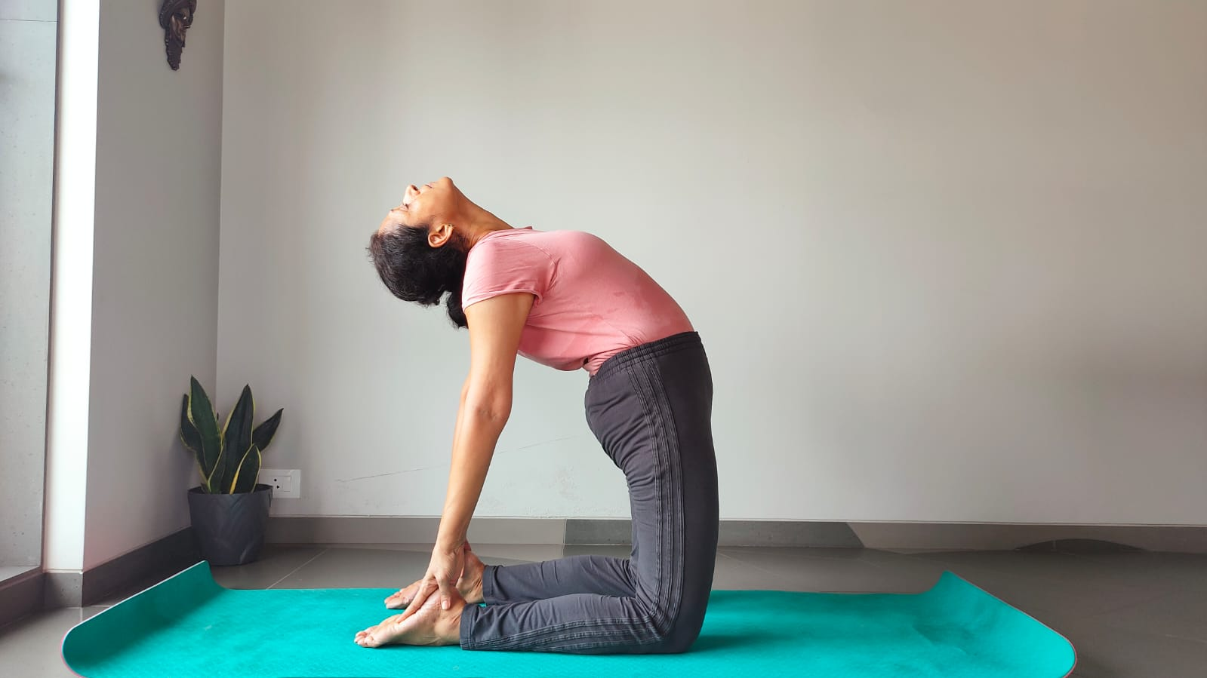
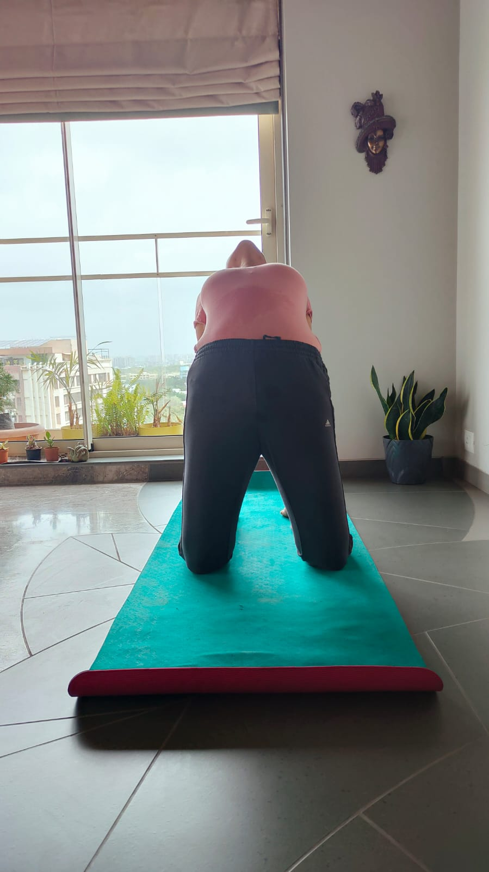
2ND POSITION NAME:-Dr Vaishali Shah -IMS -SURAT DOB:-9/12/1973 POSE:-Ustrasana

Slide 3
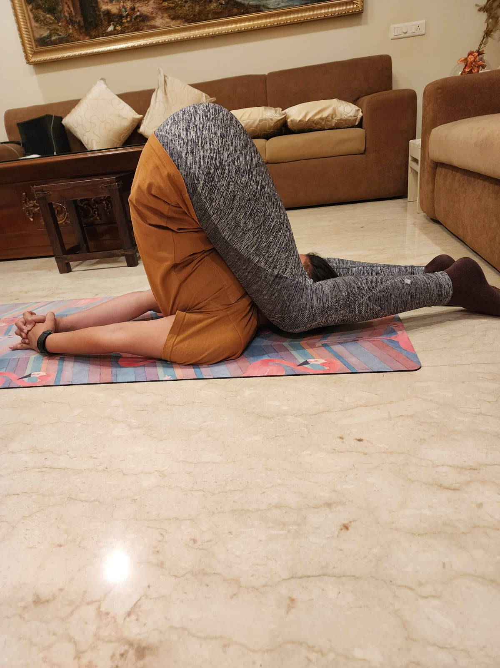
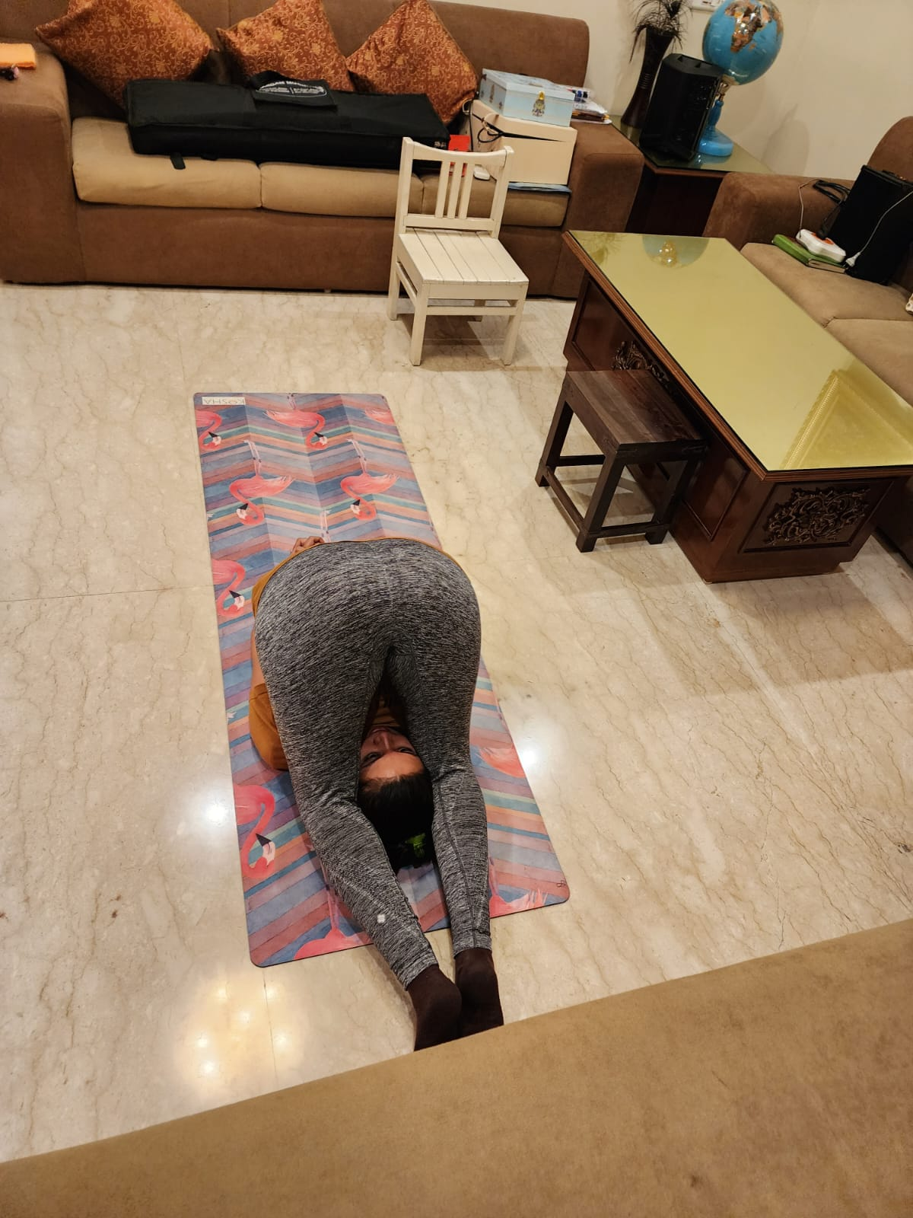
2ND POSITION Dr Sanjana khemka -Raipur DOB:-17.10.1988 POSE:-Karnapidasana

Slide 4
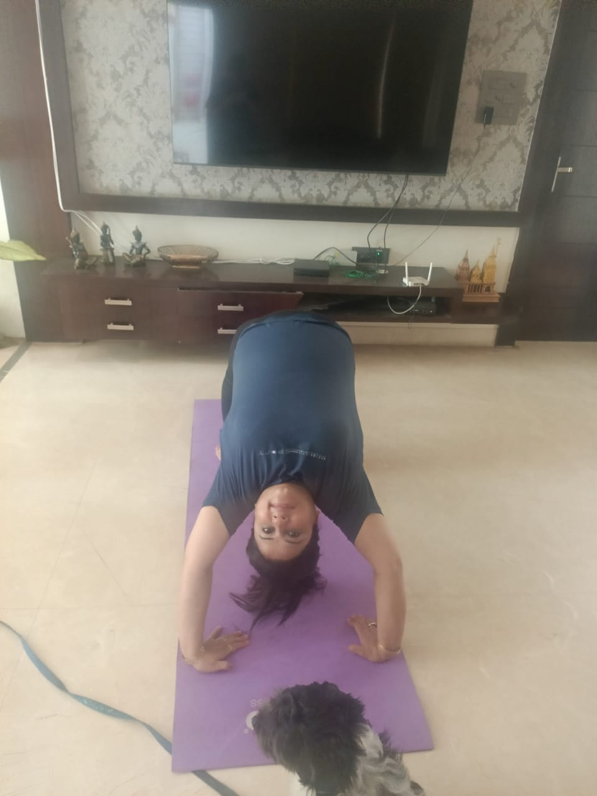
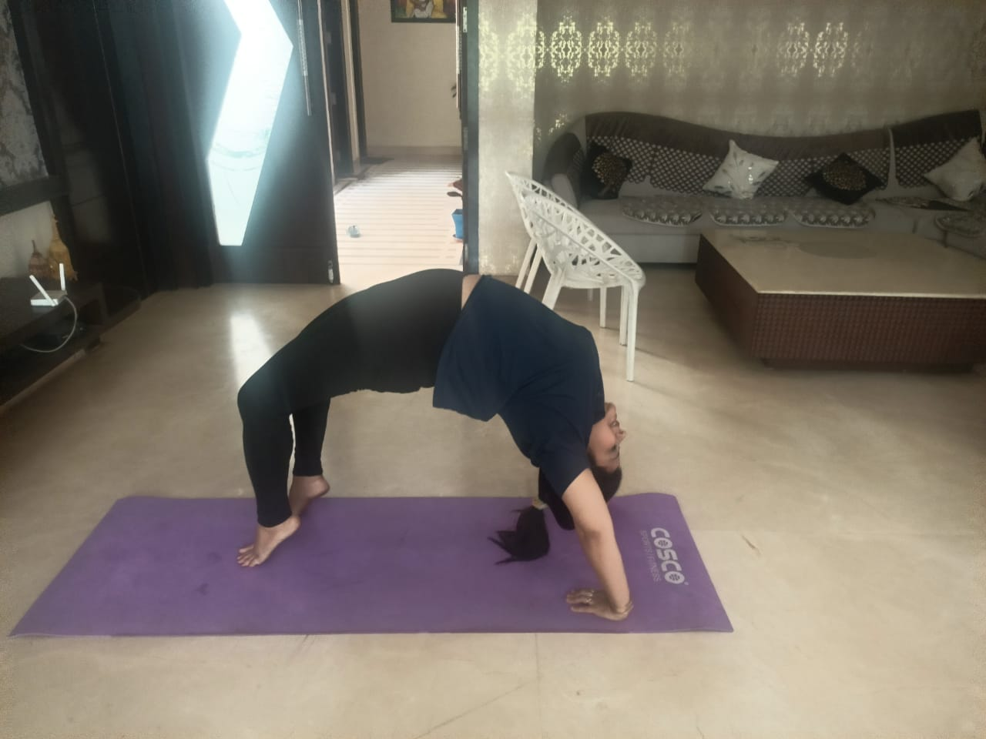
3RD POSITION NAME:- Namita Tandon,Club 35+ varanasi DOB:-12th March 1981 , 42YRS POSE:-Chakara aasan

Slide 5
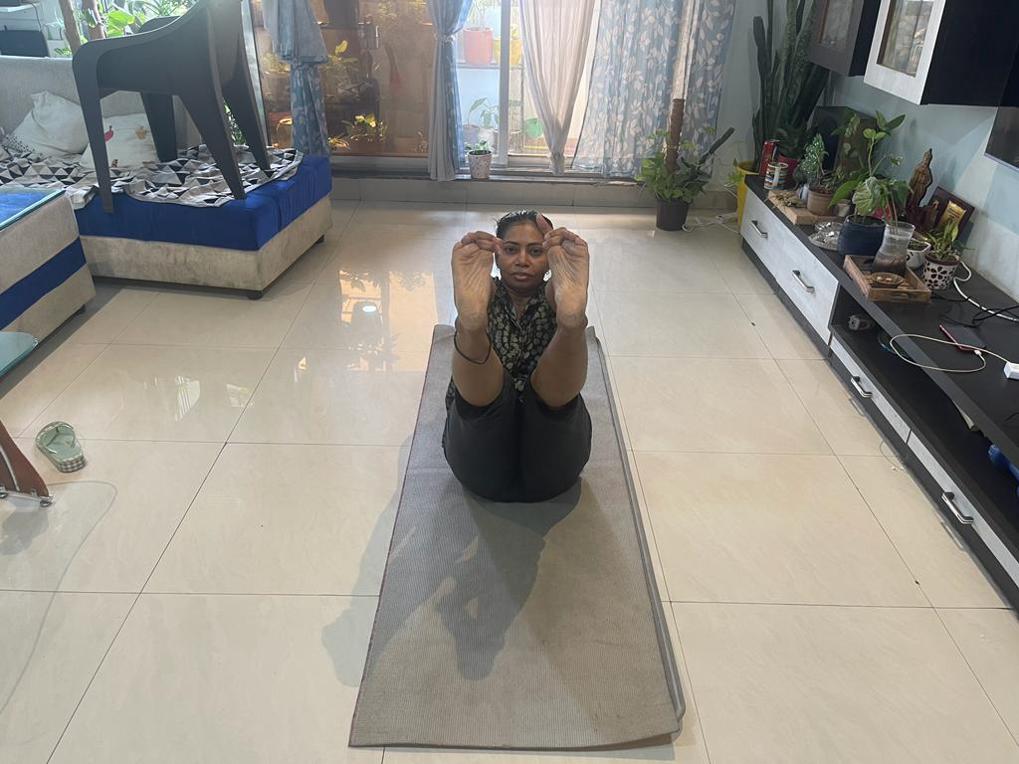
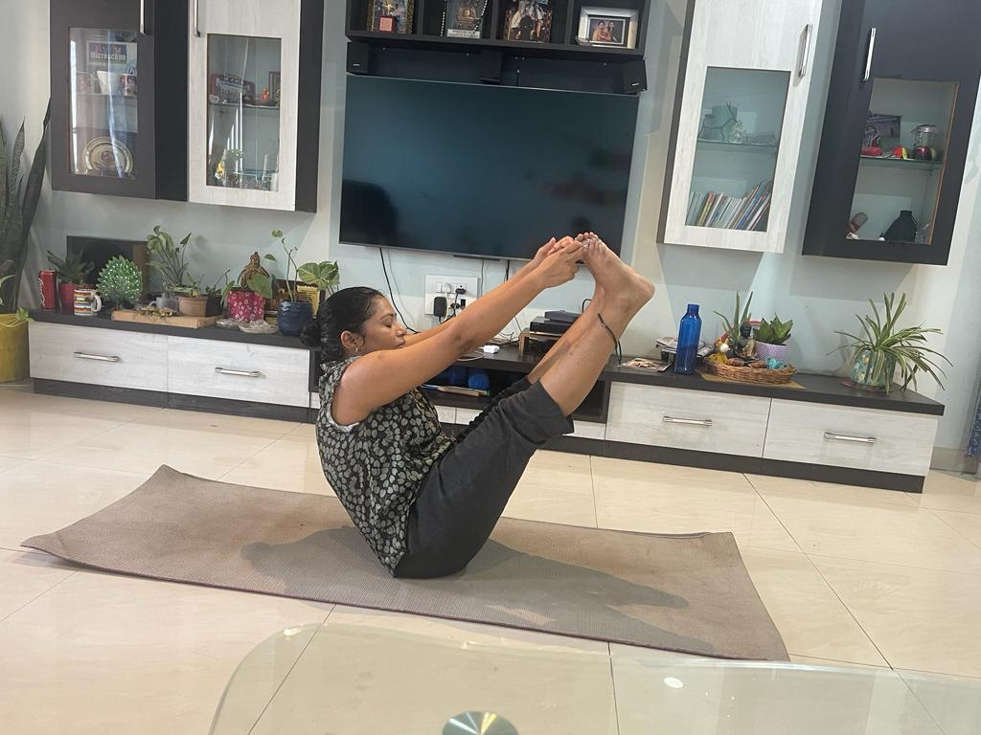
3RD POSITION NAME:- Dr Anshu j gupta -Raipur -Chhattisgarh DOB.:-25/10/1979 ,44YRS POSE:-BOAT POSE

