Slide 1
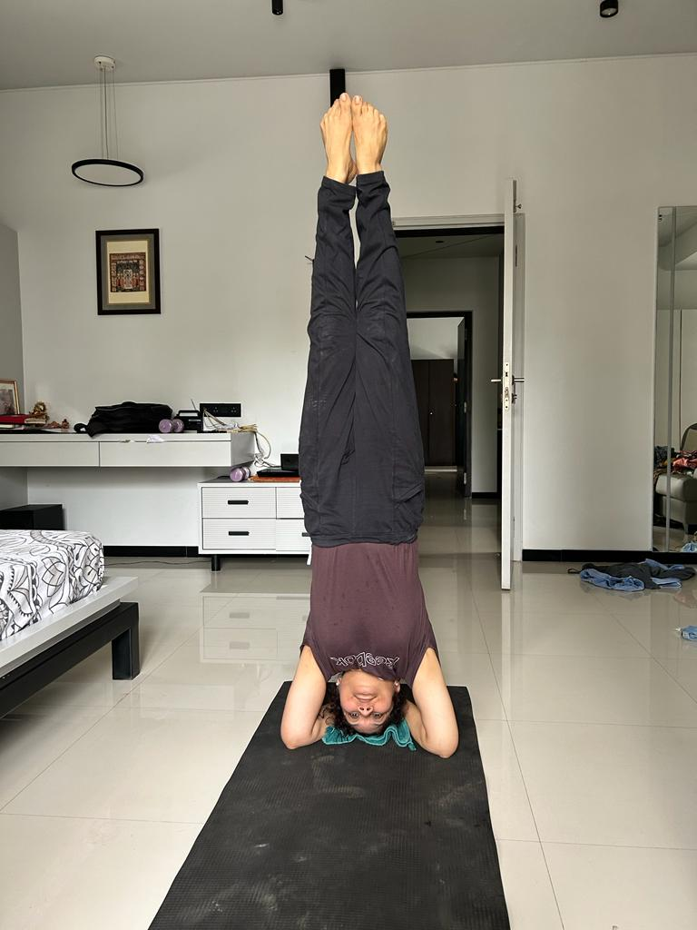
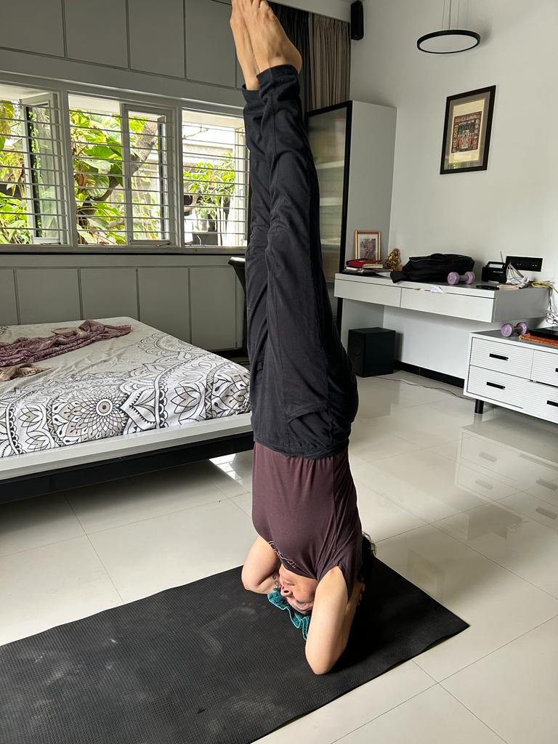
1ST POSITION
Name : Dr Alka Shah -IMS - SURAT
Age : 54 yrs
POSE:-Shirshasan

Slide 2
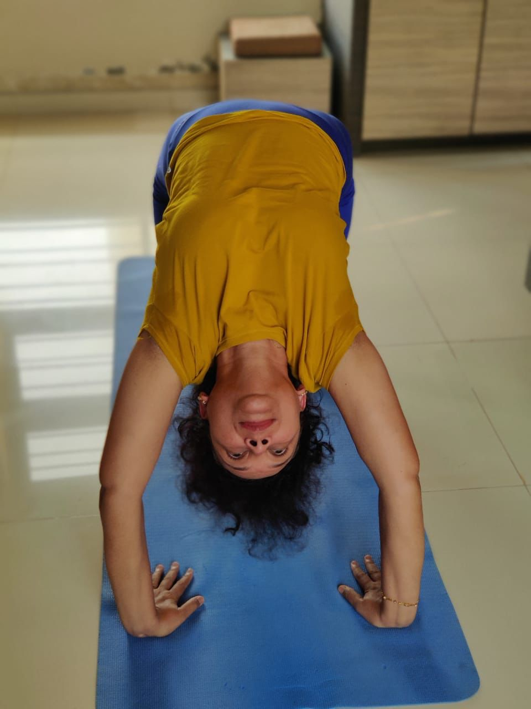
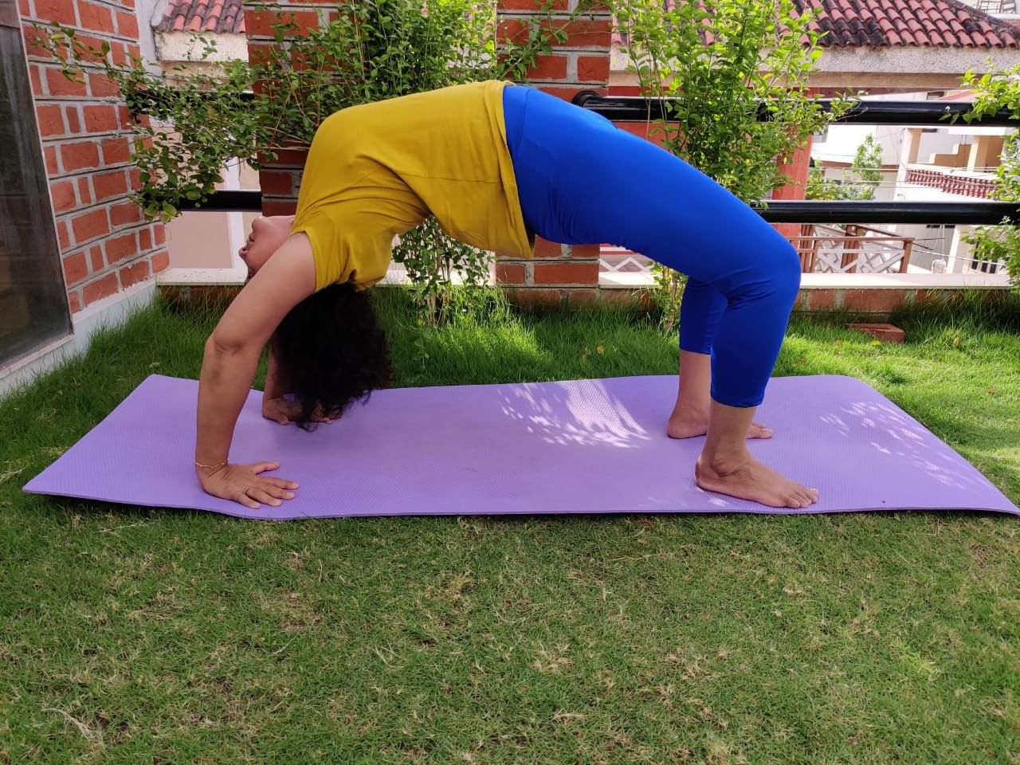
2ND POSITION
NAME:-Dr Shweta Shah ,-IMS-VADODARA
DOB:-21/02/1971 ,52 YRS
POSE:-Chakrasan

Slide 3
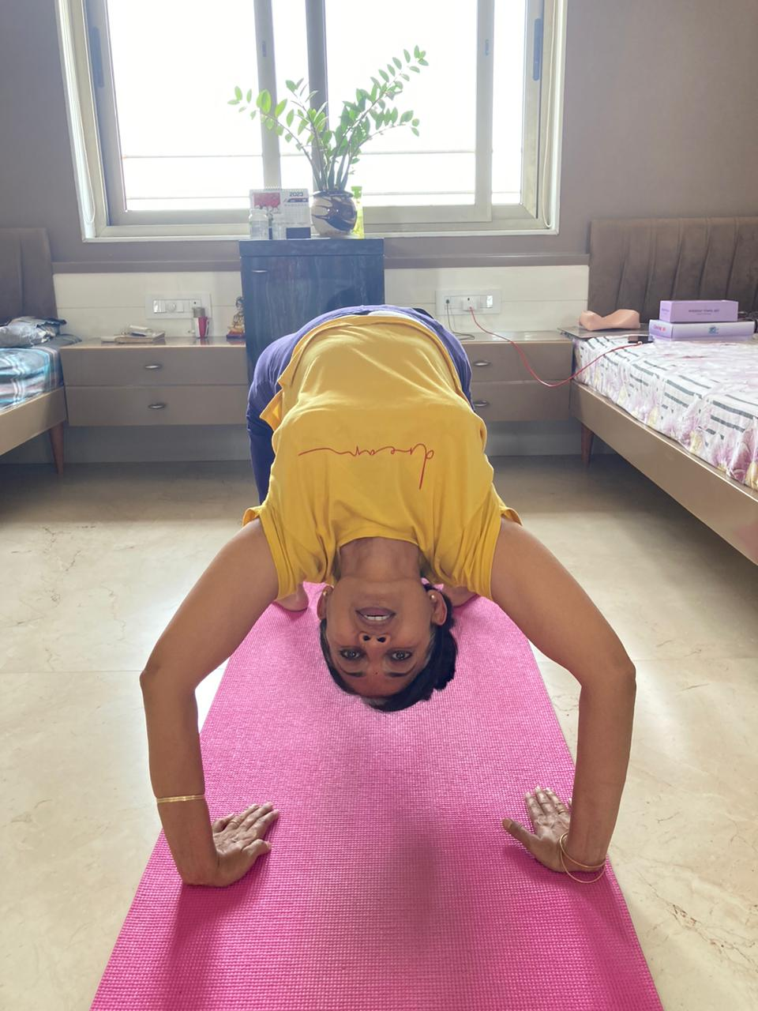
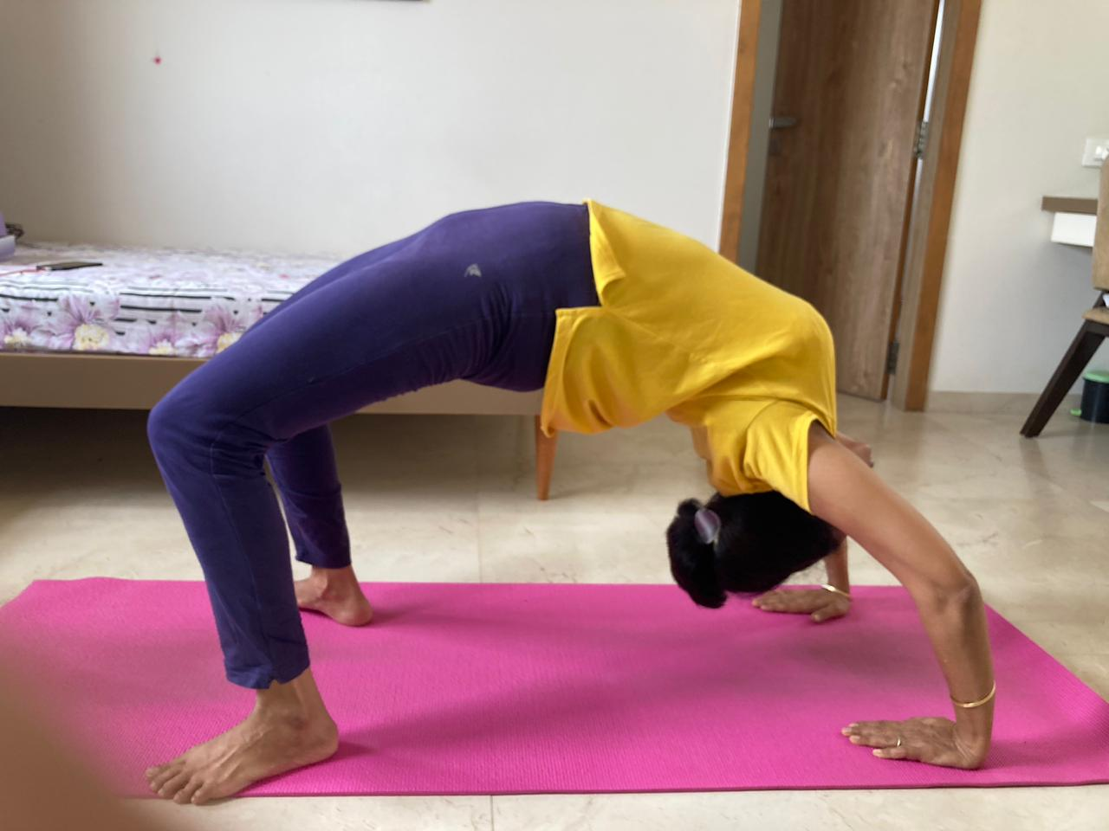
2ND POSITION
NAME:- Dr Nila Rangani -RAJKOT-IMS
DOB:- 13/9/1972
POSE:- Chakrasan

Slide 4
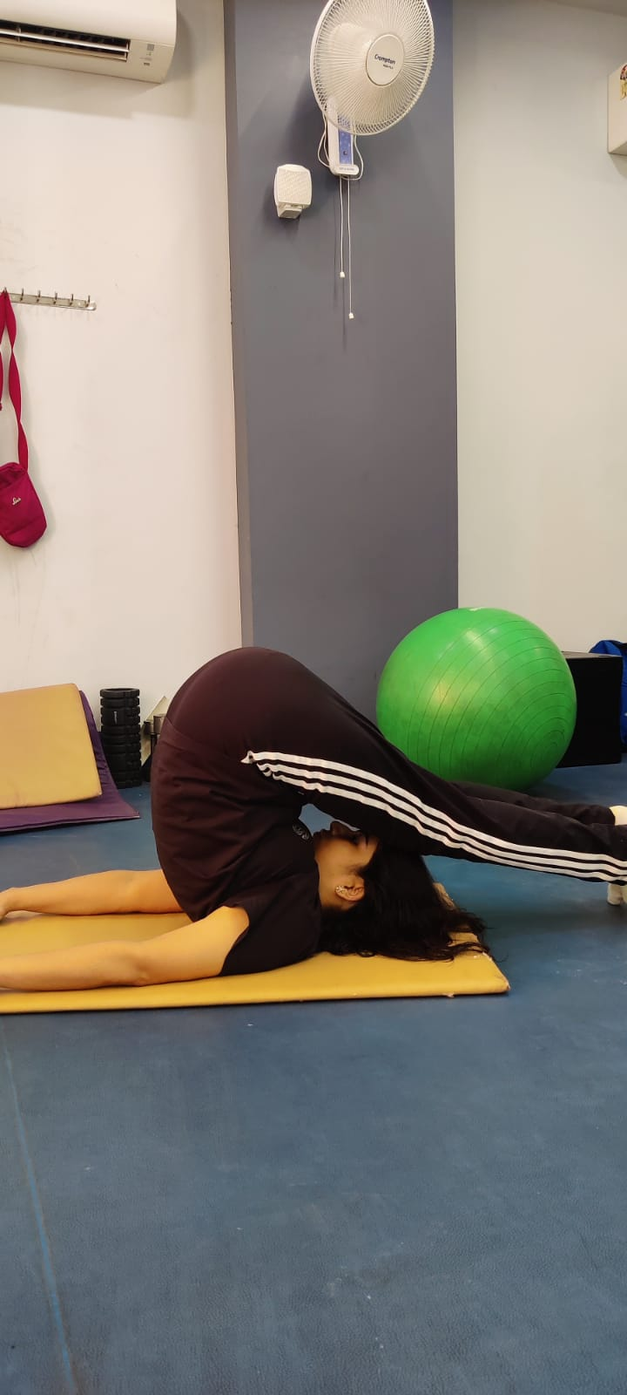
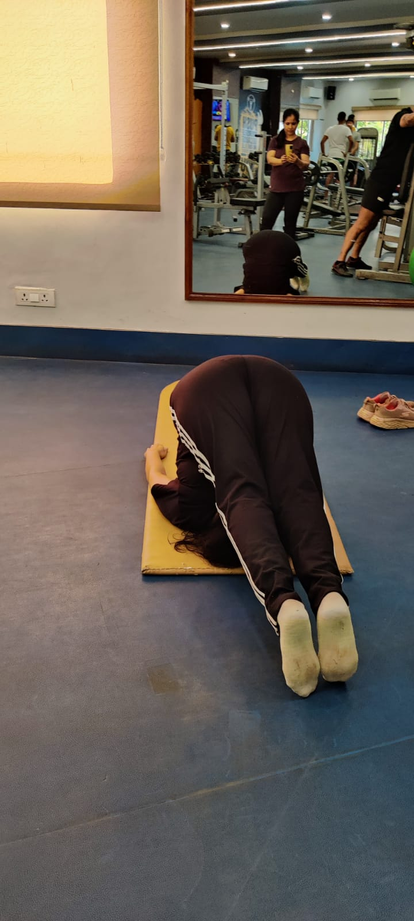
3RD POSITION
DR. NEETU YADAV-VARANSI -IMS
DOB:-12 September 1972
POSE:- HALASAN(PLOUGH POSE)

